Slide 1
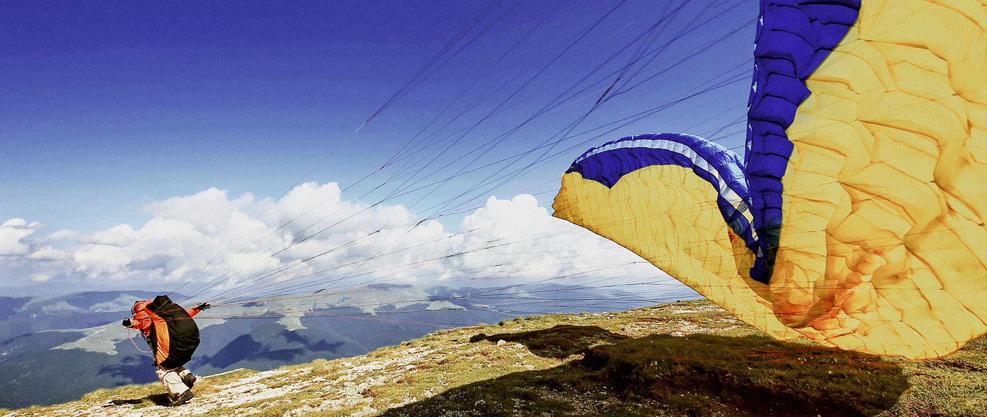
How's your bank
working from home
George Proorocu / Mihai Popa / Mihai Roman
October 2021
Notes:
MP

Slide 2
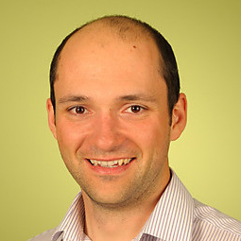
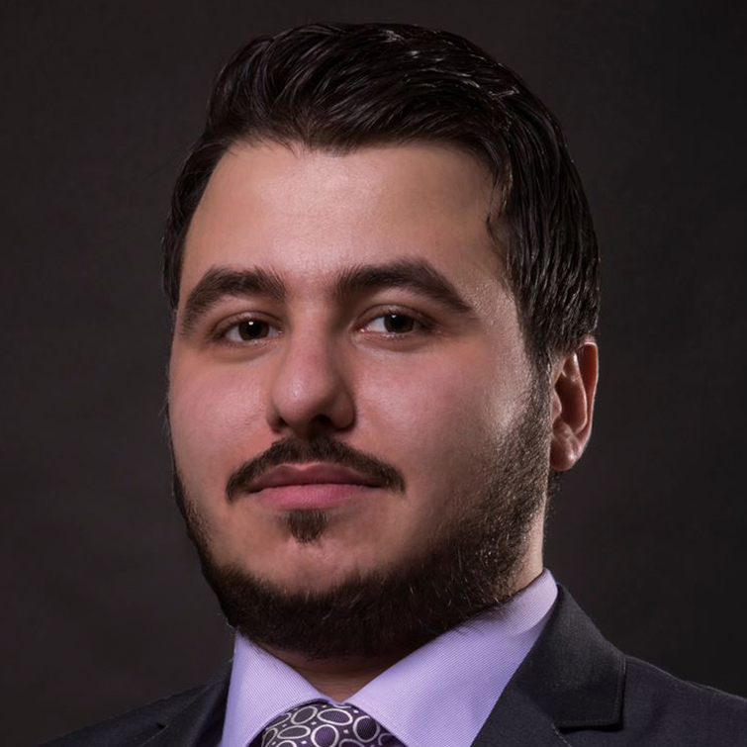
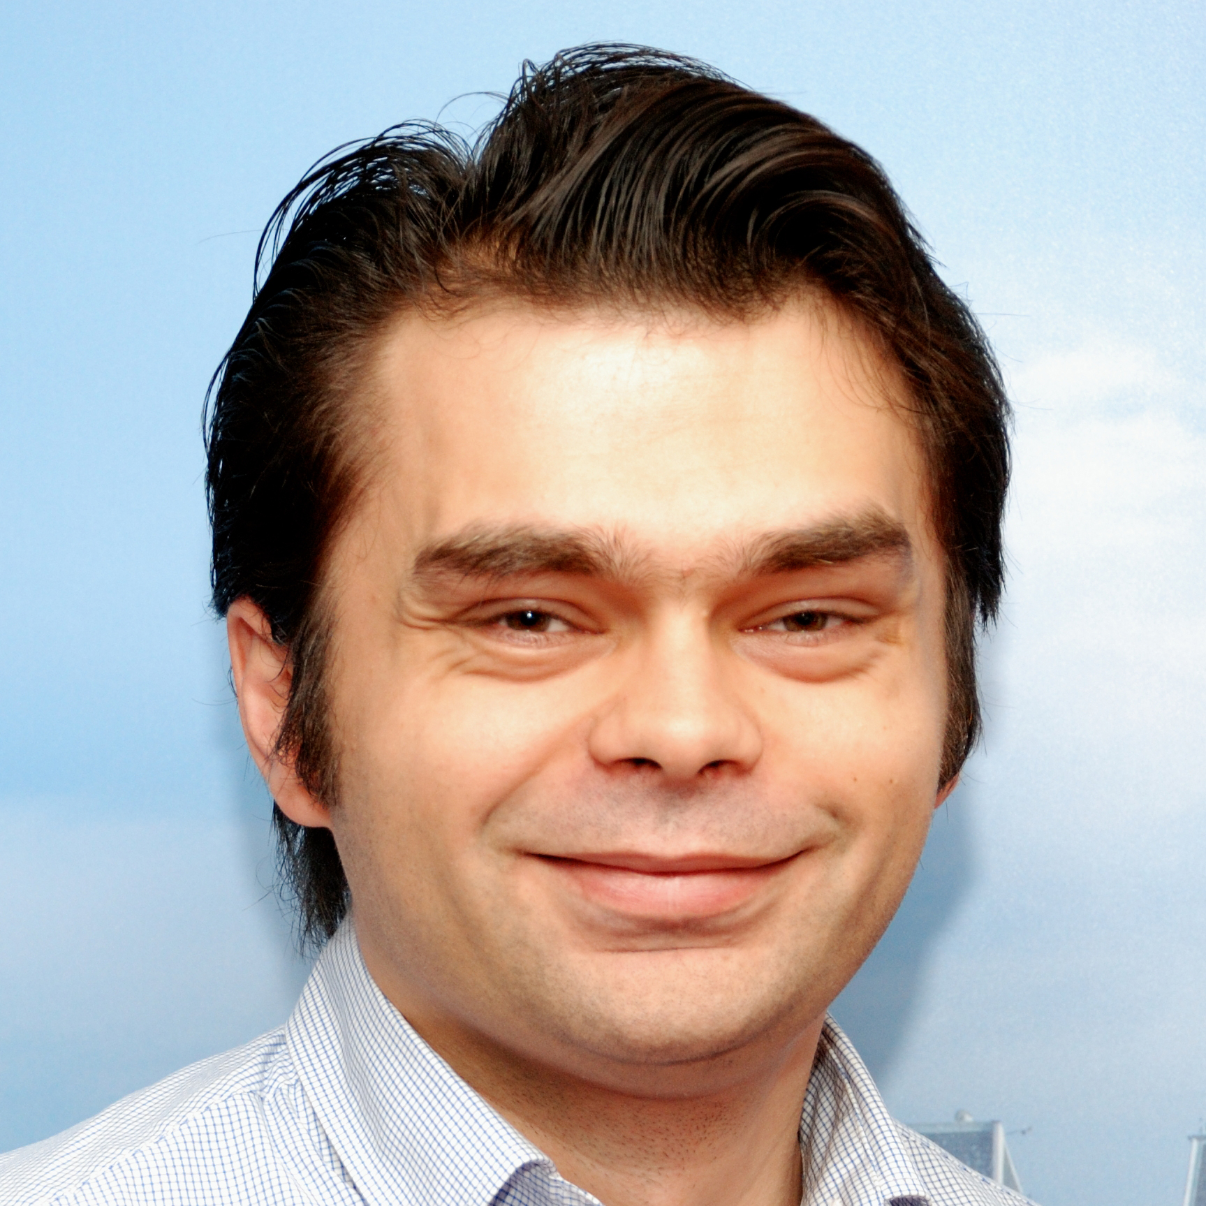
Who are we?
Mihai Popa
Head of Continuous IT Operations
George Proorocu
IT OPS Chapter Lead Cybersecurity and Fraud
Mihai Roman
Engineering Chapter Lead Cybersecurity and Fraud
@MrMihaiPopa
@AurelProorocu
@Mihai_roman
2
Notes:
MP

Slide 3
Romania
Notes:
MP

Slide 4
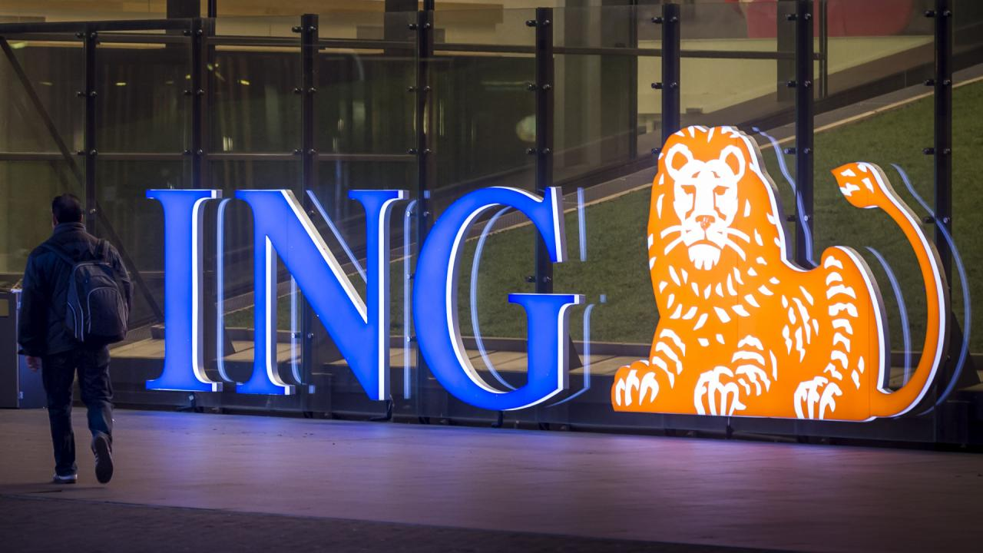
Notes:
GP

Slide 5
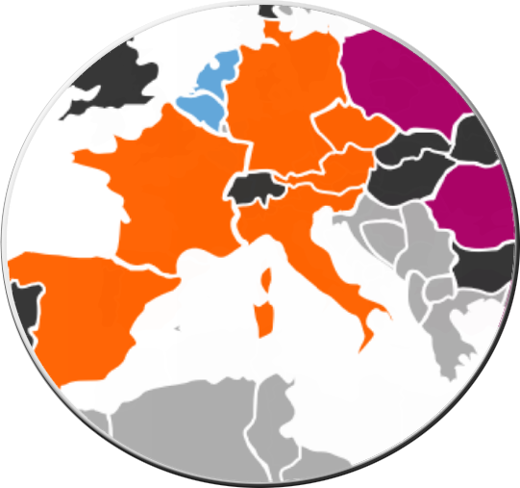
Market leaders: Netherlands, Belgium, Luxembourg
Challengers: Germany, Austria, Czech Republic, Spain, Italy, France, Australia
Growth Markets: Poland, Romania, Turkey, the Philippines and our stakes in Asia
Wholesale Banking Network and global franchises
Notes:
GP
Engineers (numbers): > 52000 employees in total
Clients (numbers) – 38+ millions
We operate in more than 40 countries in Europe, North America, South America, the Middle East, Asia and Australia
Market leaders: - Leading retail and wholesale banks - Evolving into ‘direct-first’ banks
- Improving operational excellence
Challengers:
- Leading ‘direct-first’ banks
- Further integrating retail and wholesale banking capabilities
- Broadening lending capabilities
Growth markets:
- Strong positions in fast-growing countries - Evolving into ‘direct-first’ banks
- Developing digital leadership capabilities
Wholesale banking:
International network: more than 40 countries - Extensive international client base across all regions - Global franchises

Slide 6
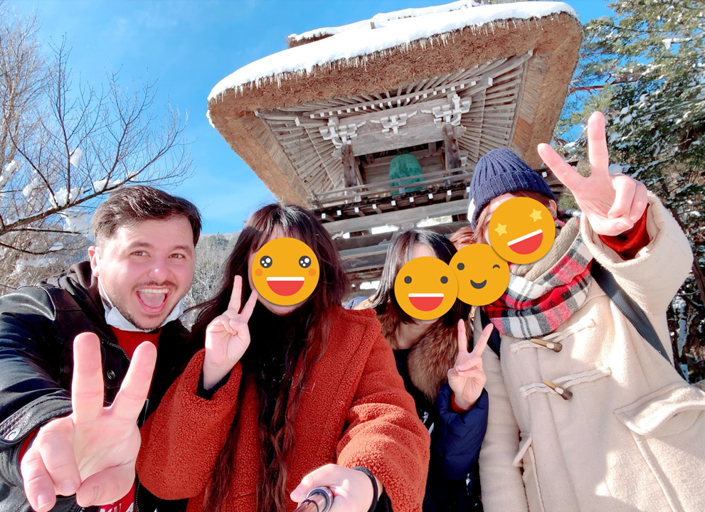
Story of how Corona started
1st February 2020
Notes:
GP:
And now let’s dive into today’s topic. For me it was quite interesting, because for me it actually started in Asia, I was there when the pandemic hit the news, and it escalated quickly, this photo was taken on 1st February in Japan. And in Asia everything was taken seriously from the beginning even in the countries were there were only a few cases, and I remember that the face masks went out of stock from one day to another. From there I came directly to a business trip in Romania. But when I arrived in Europe I was a bit shocked, coming from Asia where a strict testing was in place, masks were mandatory in some places and there were extra cautions implemented, from there I arrived in a place were people were looking strange at me for wearing a mask. Even if everything was ok, I decided to wear a mask as a precaution to protect everyone (there were not so many things known about Corona at that point, so I just wanted to have some extra safety measures in place). And this is me in the office on the 11th

Slide 7
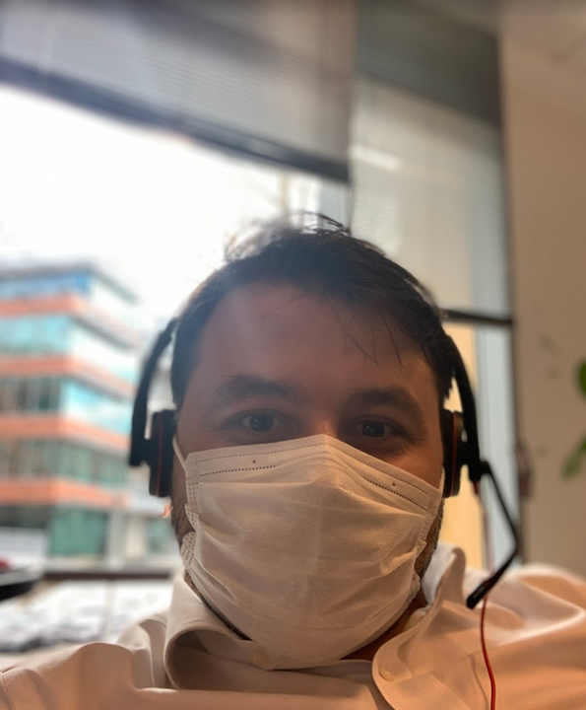
Story of how Corona started
@Office 11th February 2020
Notes:
GP:
And this is me in the office on the 11th February. But I’ll let Mihai tell you now how everything started, from a managerial point of view, since he was in Europe at that point.

Slide 8

First weeks/challenges
Started working remotely
IT challenges
HWoW – home way of working
Notes:
GP Started working remotely --> initial challenges
IT challenges --> connection, equipment (headphones), etc.
WoW adapted --> more meetings, more calls, more emails, we had to adapt the time we spent on chatting, etc. Since you couldn't talkt directly with people anymore (nu ne mai puteam duce la cineva direct sa ii zicem X, Y).
We were lucky because even before many of our colleagues were working 1-2 days/week from home so they had a set-up already in place, a let's say home-way-of-working.
HWoW – home way of working
It was slightly different now because during those initial weeks, they had the full family at home, and in some cases young children, and they were easily distracted while they were expecting to have more time to focus.

Slide 9



First 3 months
Accountability
Trust
Notes:
MP
Accountability & trust --> to trust that the people were actually working
We observed 2 different behaviours:
Burnout
Others were more relaxed
The 2 environments home & work were sudently merged into 1
What we did:
George: electric desk – during the day I stand, at night I sit on the chair (2 different states)
George: after the working hours are over – I go run, have dinner with my girlfriend, etc.
Teams: We started having coffee calls/"gossip calls"
Virtual 1:1s
Games
Game nights
Afterhours Drinking sessions

Slide 10
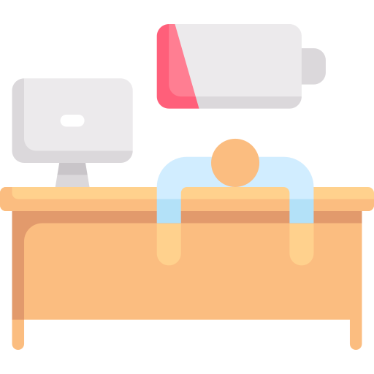

First 3 months
We observed 2 different behaviors:
Notes:
MP

Slide 11

Leading by example
Notes:
MP - Sports
- Mindfulness (meditation, yoga)
- Standing desk
- Work/Life balance - etc.

Slide 12
First 3 months – leading by example
Virtual games
Virtual coffee corners
Regular check-ins
Events
Notes:
MP

Slide 13

How did ING support us?
ING provided a rotation system:
In case they were feeling lonely at home
In case they couldn’t setup a home-office
Giving the possibility to work from another country
Offered budget/discounts for office & IT equipment
Notes:
MP
ING provided a rotation system, so that part of the people were able to go to the office:
In case they were feeling lonely at home
In case they didn’t had the possibility to setup a home-office
Giving the possibility to work from another country within EU
Offered budget/discounts for office & IT equipment, this was different in each country
In some of the countries it paid for home-staying costs
On a longer term the policy has been changed and ING encourages you to work from home as much as 60-70% of your work time
Dedicated slots in everybody’s agenda for focus (meeting-free blocks)
Pulse check surveys done every month & results/actions discussed with leadership team

Slide 14

How did ING support us?
In some of the countries it paid for home-staying costs
ING encourages you to work from home up to 60-70%
Dedicated slots in everybody’s agenda for focus (meeting-free blocks)
Pulse check surveys done every month & results/actions discussed with leadership team
Notes:
MP
ING provided a rotation system, so that part of the people were able to go to the office:
In case they were feeling lonely at home
In case they didn’t had the possibility to setup a home-office
Giving the possibility to work from another country within EU
Offered budget/discounts for office & IT equipment, this was different in each country
In some of the countries it paid for home-staying costs
On a longer term the policy has been changed and ING encourages you to work from home as much as 60-70% of your work time
Dedicated slots in everybody’s agenda for focus (meeting-free blocks)
Pulse check surveys done every month & results/actions discussed with leadership team

Slide 15



What did WE do?
More often interactions with our engineers, not only 1:1s -> connect more on a personal level
Having video calls & paying more attention to micro actions when discussing with people
We’ve kindly asked people to turn on their cameras whenever possible, and use adequate hardware (microphone) to make the transition easy
Notes:
MP We’ve learned to look at the camera while talking and having a decent posture (back straight, feet on the ground, hands in sight) -> leading with presence

Slide 16



What did WE do?
We started meeting with the people outside to have 121s while walking when the situation allowed
Created the norm for the engineers to access the majority of the tools without VPN
We trusted our people!
Notes:
MP

Slide 17

Awareness & Security
Mental health
Dummy MFA approvals
Physical security (devices, etc.)
Notes:
MR

Slide 18



Looking at the future
Hybrid / office / home
Psychological safety
Last but not least, trust the people!
Notes:
MR

Slide 19



Looking at the future - Hybrid / office / home
Let the people decide what’s best for the team
Create the environment to facilitate their conversations
Build ground rules where you facilitate the touchpoints
Be Agile
Notes:
MR

Slide 20

Looking at the future - Psychological safety
Build this, it’s important in cross functional and cross-locations
Asses where you are and measure where you want to go
Encourage good behaviors
Celebrate mistakes but not the repetition
Notes:
Build this, it’s important in cross functional and cross-locations
Asses where you are and measure where you want to go
Encourage good behaviors
Celebrate mistakes but not the repetition

Slide 21

Looking at the future - Psychological safety
Find your own way – old habits will change as the world is changing
Trust the people! Empower them
Notes:
MR

Slide 22



Conclusion
Exceptional times require exceptional measures
It’s important to support & connect with your colleagues
Create the right environment for the new normal
Stay a step ahead
Stay safe!
Notes:
GP

Slide 23








Thank you!
Q&A
ing.com
@ING_News
LinkedIn.com/company/ING
SlideShare.net/ING
Medium.com/ing-blog
ingwb.com
Facebook.com/ING
YouTube.com/ING
Flickr.com/INGGroup

